Slide 1
Capstone Progress Report
Group 44: Andrew Soltesz, Mark Sprouse, Raja Petroff

Slide 2
Raja Petroff

Slide 3
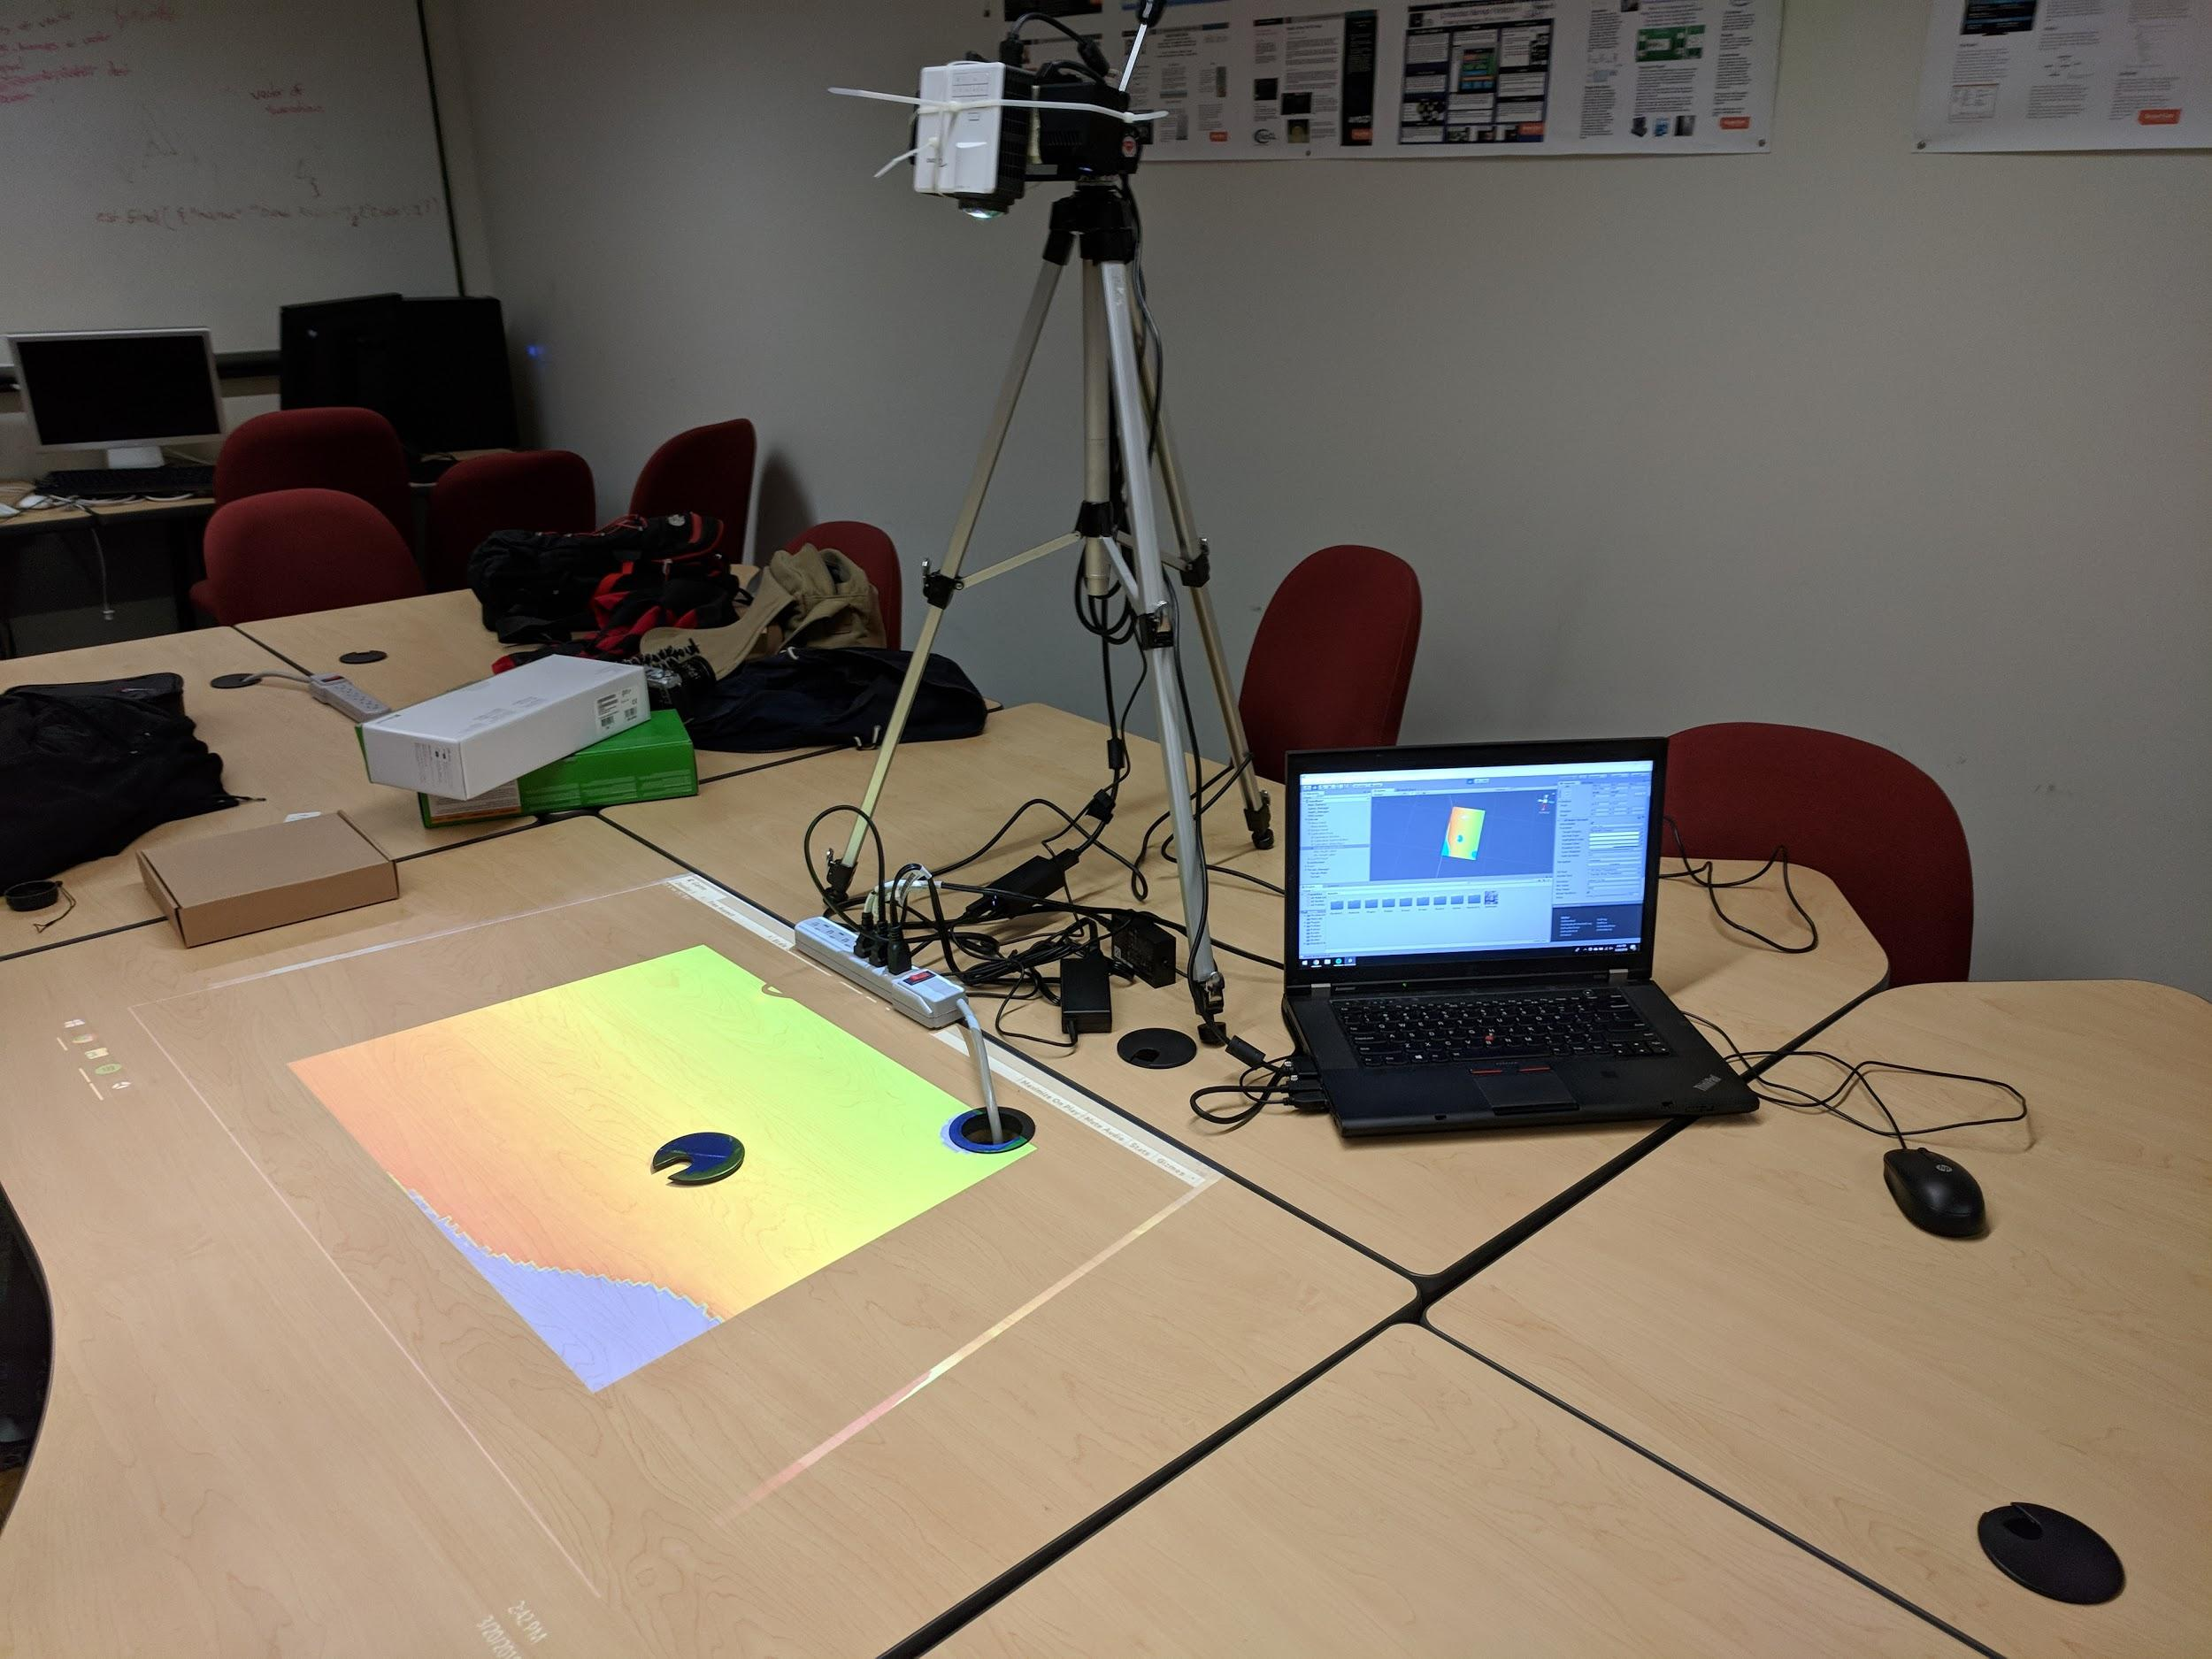
Project Recap
Project Purpose
Better collaboration and planning for engineers
Teach students cut and fill concepts
Project Goals
Augmented Reality sandbox
Manipulate terrain via sand
Visualize terrain
Road editing feature
Calculate cut and fill of road automatically
Our temporary setup for testing the software

Slide 4
Andrew Soltesz

Slide 5
Current Position
Terrain generation implemented
Triangle mesh
Updates in near real time
Depth sensor integrated
Quarter resolution
UI implemented
Unity UI system
Editable roads implemented
Cut/Fill mode implemented
Calibration mode implemented

Slide 6
Mark Sprouse

Slide 7
Encountered Problems & Solutions

Slide 8
System Crashes without Kinect connected - Problem
Crashes if Kinect unplugged while running
System can only be run by whoever has Kinect
Developers without Kinect were unable to test their code with the rest of the system

Slide 9
System Crashes without Kinect connected - Solution
Create an interface for the system to tell if there is a Kinect connected or not
When there is no Kinect, set the input to be a static image to simulate a terrain
If a Kinect is connected while system is running, switch back to normal mode

Slide 10
Joe unable to find time to meet with us - Problem
Either because of scheduling conflicts or miscommunications we were unable to meet with Joe
Wanted to demo progress thus far and get input on directions we are headed

Slide 11
Joe unable to find time to meet with us - Solution
If nobody was able to reschedule to have the meeting, we would create an email to with a synopsis of what was accomplished this week and any questions we had
If someone could make it, we would send them and have them fill the others in on what was stated

Slide 12
Cut & Fill lowering performance of system - Problem
The Cut & Fill calculations very expensive
Had to traverse road for input
Perform calculations on that input
In tandem with standard system operations

Slide 13
Cut & Fill lowering performance of system - Solution
Created timer to create interval between calculations
Calculations only need to be done again if there is a change to the terrain or road
Still tweaking to achieve best performance with best responsiveness

Slide 14
Periods of time sick or swamped - Problem
Everyone got ill at least once from cold weather or general school reasons
Everyone had a period of time where they were swamped with additional schoolwork and unable to find time for the sandbox

Slide 15
Periods of time sick or swamped - Solution
Made everyone’s work as self-contained as possible to reduce dependencies
Were able to assist others if they requested it
Not much we can do to prevent but can react as best we can

Slide 16
Raja Petroff

Slide 17
Future Tasks
Fix root control point of road in design mode
Make cut and fill mode calculations more efficient
Save state of calibration mode so we don’t have to change it every time

Slide 18
Retrospective
Completed beta release
Implemented required features on time
Created project roadmap
Shows what we have left to do
Need to document code
Need to track and create list of bugs

Slide 19
Demonstration of Beta Level Functionality

